Slide 1
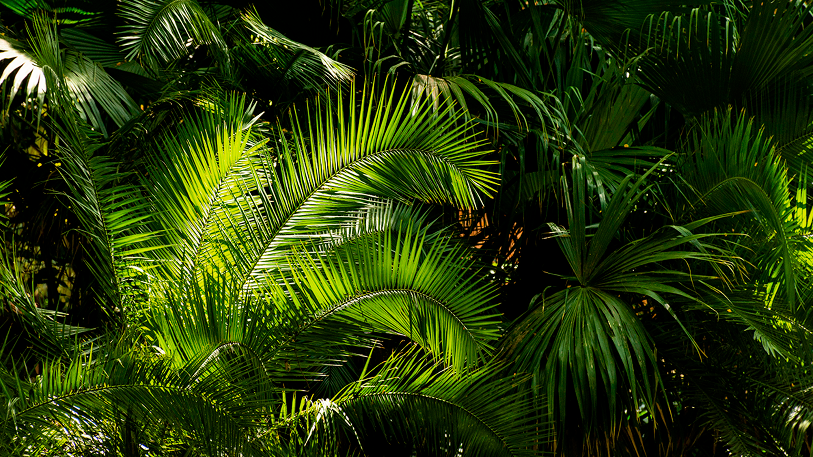

NewLeaf
by JMAL

Slide 2
TABLE OF
01.
02.
03.
The Issue
The Solution
The Demo
04.
06.
The Impact
The Costs
contents
The problem we’re facing
The solution we designed
The demonstration of our solution
05.
Improvements
The impact our solution would have
The cost of our solution
How we can make NewLeaf better

Slide 3

01.
The Issue
our problem

Slide 4
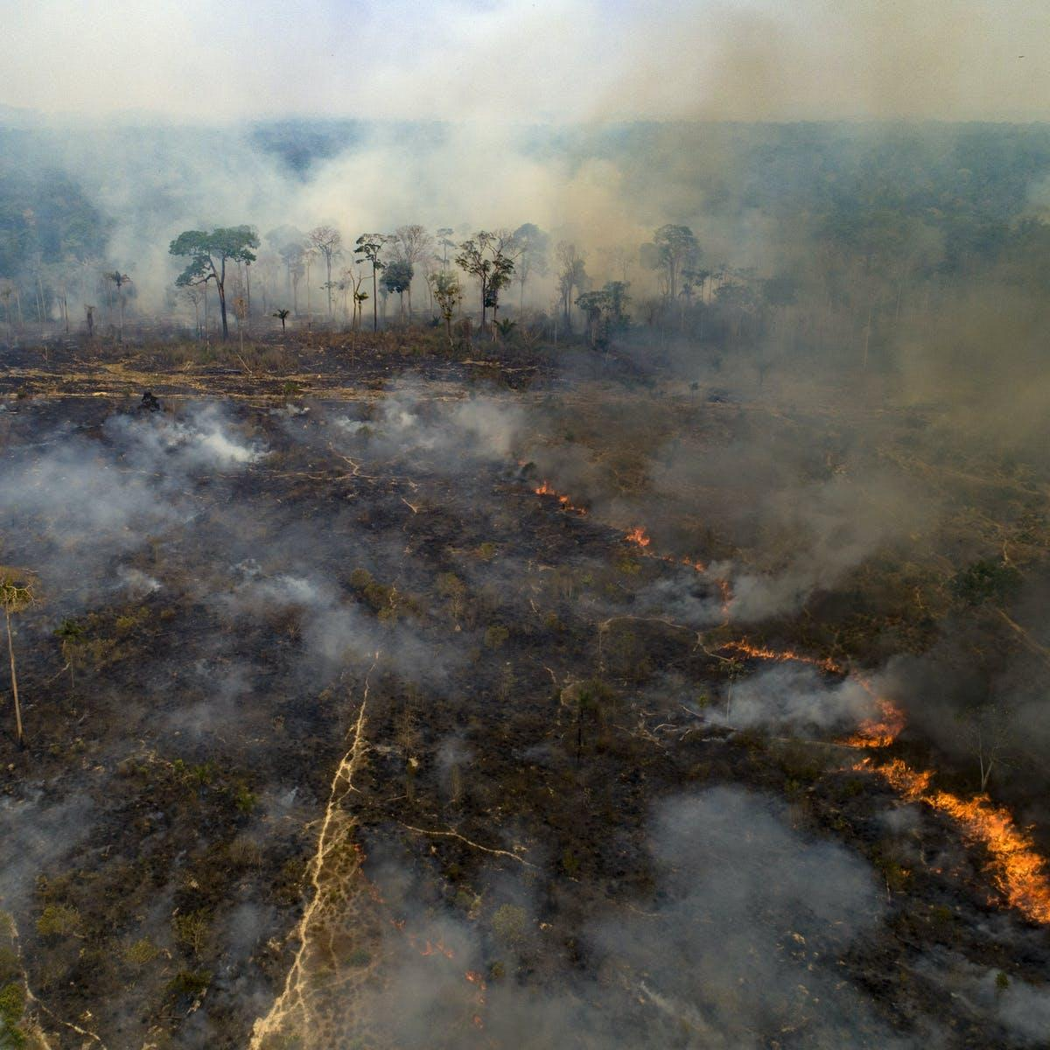
The Issue
Forests are threatened by various dangers including illegal logging and wildfires that have drastic effects worldwide.
Over 700,000 square kilometers of the Amazon rainforest lost, releasing 4.8 billion tonnes of carbon dioxide.
10 billion dollars a year in the global market.
Wildfires result in 7 billion tonnes of carbon dioxide in emissions per year for the past 20 years.
150 billion dollars lost by The California wildfires in 2018.
These threats to forests have severe consequences for the entire world.

Slide 5
02.
The Solution
to our problem

Slide 6

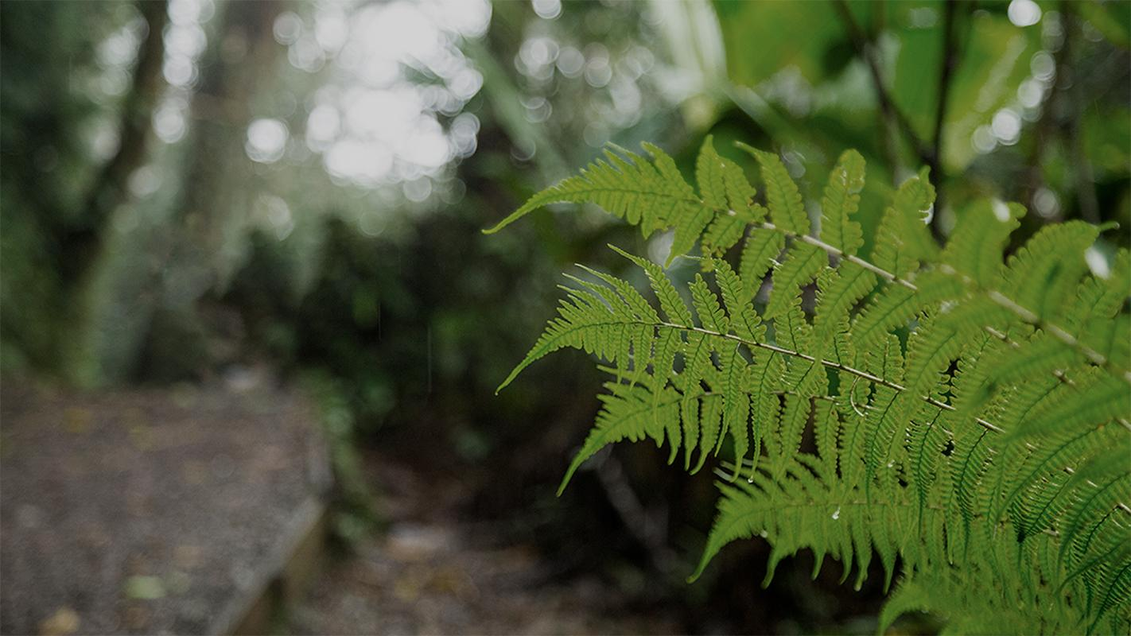
Our Solution:
NewLeaf
Cost efficient and low maintenance, this compact smart surveillance system watches over forests at high risk of deforestation or forest fires. It utilizes video and audio sensors, and through machine learning algorithms, can alert authorities in cases of emergencies, reducing forest loss and aiding conservation efforts.

Slide 7
03. The DEMO

Slide 8
04.
Our Impact
on the world

Slide 9
The Impact
A Greener Future
By implementing cameras in forests at high risk, fires and deforestation could be prevented at the source, saving billions of dollars and the environment.
Illegal Logging (500 mile radius)
Forest Fires
(700 mile radius)

Slide 10
05.
The Cost
of our project

Slide 11

Cost:
MATERIALS
INSTALLATION
UPKEEP
TOTAL
the numbers
The computing systems and casing would cost approximately $550 USD per system
Setting up an individual camera would cost approximately $400 USD per system
For a real time update system and maintenance, the cost would be $400 USD a year per system
Each individual system would cost $1350 USD based on off the shelf estimates. Beta tests in the Amazon would use about 400 cameras to cover and protect around 100 square miles (2,787,840,000 square feet), projecting only around $675,000 over a one year period. If successful in protection and surveillance, this could scale to a multi-million dollar effort to protect worldwide forests, saving billions of dollars and our planet.

Slide 12
06.
Improvements
making NewLeaf better

Slide 13
Improvements:
Next Steps
Improved/Infrared Camera: While the Raspberry Pi camera is a good starting point, a stronger camera would allow for longer range and focus, increasing the accuracy of each box. An infrared camera would be also helpful in order to improve sensory abilities
Temperature Sensor: A temperature sensor along with our visual sensor could detect wildfires with more accuracy, as increasing temperature could warrant an early detection.
In-House Manufacturing: Manufacturing equipment ourselves could cut costs and allow us to have better control over quality.
Outreach: Through direct partnering with organizations ranging from documentary producers to local officials, we can spread awareness and improve our data directly from the source.

Slide 14
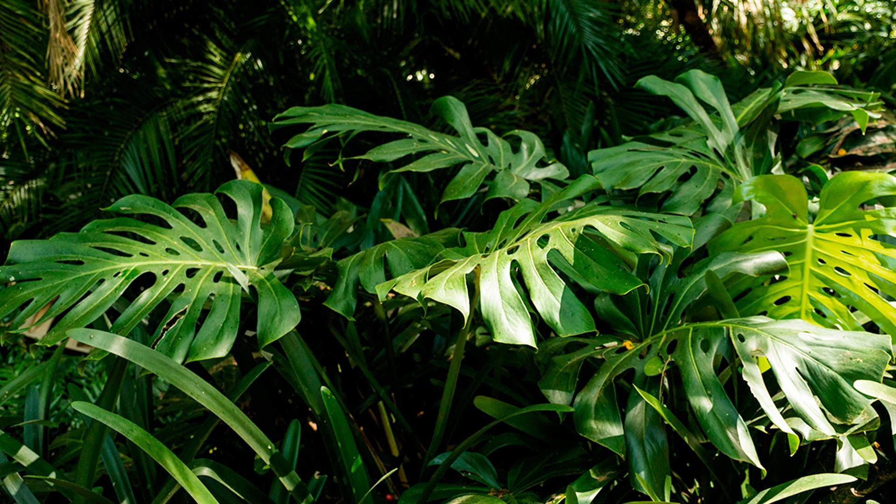
THANK YOU
have a great day :)
Sources Cited:
DuckDuckGO (Image Scraping)
WWF Illegal logging (general information)
https://www.bbc.com/news/world-latin-america-55130304
https://www.amazonconservation.org/what-we-do/protect-wild-places/
https://www.climatecouncil.org.au/deforestation/
CREDITS: This presentation template was created by Slidesgo, including icons by Flaticon and infographics & images by Freepik

Slide 15


Our Sources
https://wwf.panda.org/discover/knowledge_hub/where_we_work/amazon/amazon_threats/other_threats/logging_amazon/
https://www.google.com/url?q=https://www.conserve-energy-future.com/causes-effects-solutions-illegal-logging.php&sa=D&source=editors&ust=1627230479082000&usg=AOvVaw1PJFhK2OEUPBbPkpGC5jnl
https://www.google.com/url?q=https://insideclimatenews.org/news/23082018/extreme-wildfires-climate-change-global-warming-air-pollution-fire-management-black-carbon-co2/&sa=D&source=editors&ust=1627236790257000&usg=AOvVaw19A4TcUoCXNbQNhp9El7si
https://freesound.org/
https://www.walmart.com/ip/LYUMO-Polycrystal-Solar-Panel-Solar-Panel-Portable-4W-5V-Polycrystal-Solar-Panel-Laminated-Board-Component-DIY-Accessory/930144767?wmlspartner=wlpa&selectedSellerId=15913&&adid=22222222227353611365&wl0=&wl1=g&wl2=c&wl3=472985381015&wl4=pla-979061557329&wl5=1018369&wl6=&wl7=&wl8=&wl9=pla&wl10=118787315&wl11=online&wl12=930144767&veh=sem&gclid=Cj0KCQjw9O6HBhCrARIsADx5qCQ4-cQHu8CkIsKdTHi_rR0MgAa6r7B0uPYDBHp26EB6IgcWlMmZhPcaAiMKEALw_wcB&gclsrc=aw.ds

Slide 16
Our Sources
https://www.walmart.com/ip/Rechargeable-12V-11000mAh-9V-14500mAh-5V-26400mAh-DC-Output-Lithium-ion-Battery-Pack-LED-Strip-CCTV-Camera-Portable-Li-ion-Power-Bank-AC-DC-Charger-B/411259611?wmlspartner=wlpa&selectedSellerId=8045&&adid=22222222227441460701&wl0=&wl1=g&wl2=c&wl3=520939766778&wl4=pla-1261590893455&wl5=1018369&wl6=&wl7=&wl8=&wl9=pla&wl10=117437275&wl11=online&wl12=411259611&veh=sem&gclid=Cj0KCQjw9O6HBhCrARIsADx5qCQPPlikkpii77Qe9xsxyDoDnoBBZApLPSMO7Bscz5Qj8SU2CY2j1woaAvuPEALw_wcB&gclsrc=aw.ds
https://www.sciencedaily.com/releases/2020/12/201207112306.htm

